Slide 1


Noida Institute of Engineering and Technology, Greater Noida
Advanced Data Structure
Unit: 2
Design & Analysis of Algorithms
ACSE0501
Faculty Name:
Ms. Anamika Chaudhary
Affiliation:
Assistant Professor
Department:
DS
B.Tech 5th Sem

Slide 2

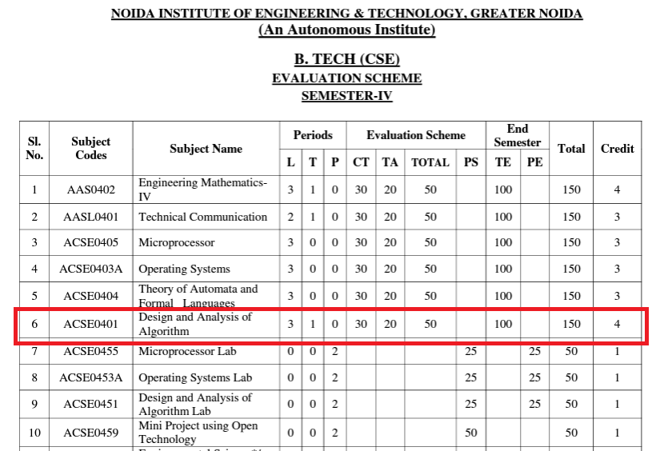
Evaluation Scheme

Slide 3

Syllabus

Slide 4
Branch wise Application
First, we will start with the internet which is very much important for our daily life and we cannot even imagine our life without the internet and it is the outcome of clever and creative algorithms. Numerous sites on the internet can operate and falsify this huge number of data only with the help of these algorithms.
The everyday electronic commerce activities are massively subject to our data, for example, credit or debit card numbers, passwords, OTPs, and many more. The centre technologies used incorporate public-key cryptocurrency and digital signatures which depend on mathematical algorithms.
Even an application that doesn't need algorithm content at the application level depends vigorously on the algorithm as the application relies upon hardware, GUI, networking, or object direction and all of these create a substantial use of algorithms.
There are some other vital use cases where the algorithm has been used such as if we watch any video on YouTube then next time we will get related-type advice as recommended videos for us.

Slide 5
Course Outcome
At the end of the semester, the student will be able:
 | Description | Bloom’s Taxonomy
CO1 | To have knowledge of basic principles of algorithm design and Analysis, asymptotic notations and growth of functions for time and space complexity analysis and applying the same in different sorting algorithms | Knowledge, analysis And design
CO2 | To apply different problem-solving approaches for advanced data structures | Knowledge, analysis And apply
CO3 | To apply divide and conquer method for solving merge sort, quick sort, matrix multiplication and Greedy Algorithm for solving different Graph Problem. | Knowledge, analysis and Apply
CO4 | To analyze and apply different optimization techniques like dynamic programming, backtracking and Branch & Bound to solve the complex problems | Knowledge, Analysis And Apply
CO5 | To understand the advanced concepts like NP Completeness and Fast Fourier Transform, to analyze and apply String Matching, Approximation and Randomized Algorithms to solve the complex problems | Knowledge, Analysis and Apply

Slide 6
Program Outcome
At the end of the semester, the student will be able:
POs | Engineering Graduates will be able to
PO1 | Engineering Knowledge
PO2 | Problem Analysis
PO3 | Design & Development of solutions
PO4 | Conduct Investigation of complex problems
PO5 | Modern Tool Usage
PO6 | The Engineer and Society
PO7 | Environment and sustainability
PO8 | Ethics
PO9 | Individual & Team work
PO10 | Communication
PO11 | Project management and Finance
PO12 | Life Long Learning

Slide 7
CO-PO and PSO Mapping
Design and Analysis of Algorithm (kCS-502)
CO.K | PO1 | PO2 | PO3 | PO4 | PO5 | PO6 | PO7 | PO8 | PO9 | PO10 | PO11 | PO12
ACSE0401.1 | 3 | 3 | 3 | 3 | 2 | - | - | - | 2 | 2 | - | 3
ACSE0401.2 | 3 | 3 | 3 | 3 | 2 | 2 | - | 1 | 1 | 1 | - | 3
ACSE0401.3 | 3 | 3 | 2 | 3 | 3 | 2 | - | 2 | 1 | 1 | 2 | 3
ACSE0401.4 | 3 | 3 | 3 | 3 | 2 | 2 | - | 2 | 2 | 1 | 3 | 3
ACSE0401.5 | 2 | 2 | 2 | 2 | 2 | 2 | - | 2 | 1 | 1 | 1 | 2
Average | 2.8 | 2.8 | 2.6 | 2.8 | 2.2 | 1.6 | - | 1.8 | 1.4 | 1.2 | 1.2 | 2.8

Slide 8
Program Educational Objectives(PEOs)
PEO1: To have an excellent scientific and engineering breadth so as to
comprehend, analyze, design and provide sustainable solutions for
real-life problems using state-of-the-art technologies.
PEO2:To have a successful career in industries, to pursue higher studies or
to support enterpreneurial endeavors and to face global challenges.
PEO3:To have an effective communication skills, professional attitude,
ethical values and a desire to learn specific knowledge in emerging
trends, technologies for research, innovation and product
development and contribution to society.
PEO4: To have life-long learning for up-skilling and re-skilling for
successful professional career as engineer, scientist, enterpreneur
and bureaucrat for betterment of society

Slide 9
Result Analysis

Slide 10
End Semester Question Paper Template
B TECH
(SEM-V) THEORY EXAMINATION 20__-20__
DESIGN AND ANALYSIS OF ALGORITHMS
Time: 3 Hours Total Marks: 100
Note: 1. Attempt all Sections. If require any missing data; then choose suitably.
SECTION A
Attempt all questions in brief. 2 x 10 = 20
Q.No. | Question | Marks | CO
1 |  | 2
2 |  | 2
. |  | .
10 |  | 2

Slide 11
End Semester Question Paper Templates
SECTION B
2. Attempt any three of the following: 3 x 10 = 30
SECTION C
3. Attempt any one part of the following: 1 x 10 = 10
Q.No. | Question | Marks | CO
1 |  | 10
2 |  | 10
. |  | .
5 |  | 10
Q.No. | Question | Marks | CO
1 |  | 10
2 |  | 10

Slide 12
End Semester Question Paper Templates
4. Attempt any one part of the following: 1 x 10 = 10
5. Attempt any one part of the following: 1 x 10 = 10
6. Attempt any one part of the following: 1 x 10 = 10
Q.No. | Question | Marks | CO
1 |  | 10
2 |  | 10
Q.No. | Question | Marks | CO
1 |  | 10
2 |  | 10
Q.No. | Question | Marks | CO
1 |  | 10
2 |  | 10

Slide 13
Prerequisite and Recap
Prerequisite
Basic concept of c programming language.
Concept of stack, queue and link list.
Recap
Flow Chart
Algorithm

Slide 14
Unit Content
Red-Black trees
B – trees
Binomial Heap
Fibonacci Heaps
Tries
Skip list.
.

Slide 15
Unit Objective
Upon completion of this course, students will be able to do the following:
Analyze the asymptotic performance of algorithms.
Write rigorous correctness proofs for algorithms.
Demonstrate a familiarity with major algorithms and data structures.
Apply important algorithmic design paradigms and methods of analysis.
Synthesize efficient algorithms in common engineering design situations.
.

Slide 16
Topic Objective
This Objective of this unit is to make the students aware about
Advanced data structures
Red Black Tree
B Trees
Fibonacci Heap
Binomial Heap
Tries
Skip list.

Slide 17
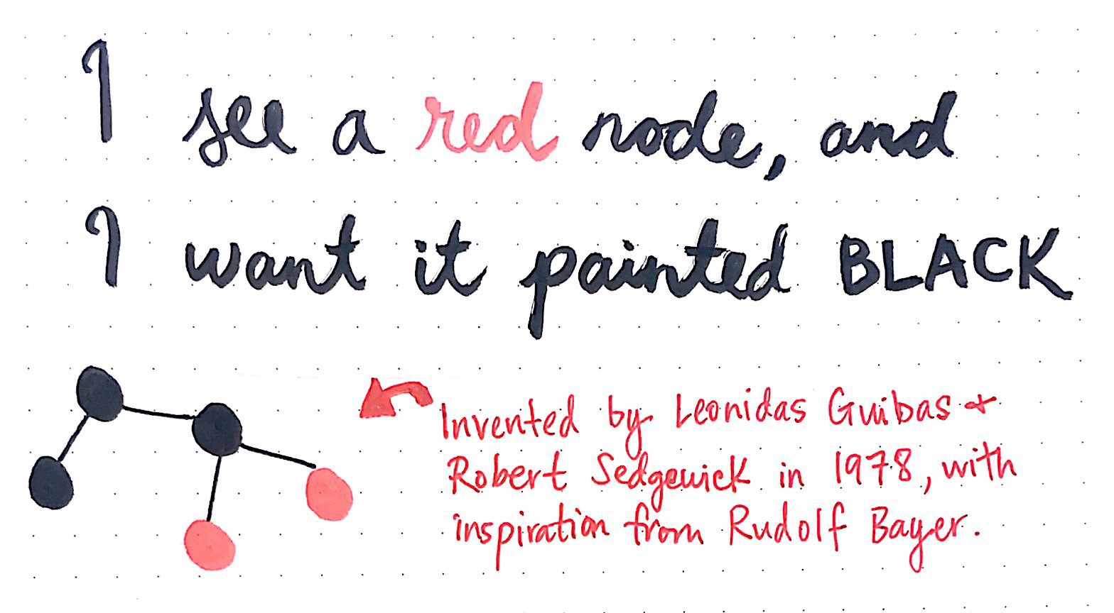
Red Black Trees(CO2)
Image Source: Comp 122, Spring 2004

Slide 18
Red Black Trees(CO2)
Why Red Black Tree
Most of the BST operations (e.g., search, max, min, insert, delete.. etc) take O(h) time where h is the height of the BST.
Red-black trees are a variation of binary search trees to ensure that the tree is balanced.
Height is O(lg n), where n is the number of nodes.
Operations take O(lg n) time in the worst case.

Slide 19
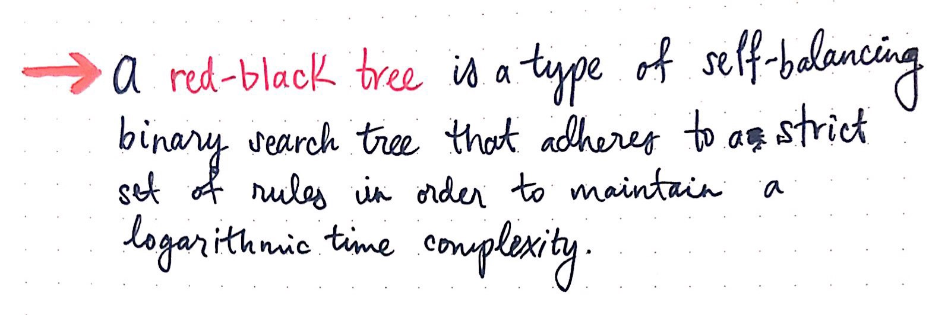
Red Black Trees(CO2)

Slide 20
Red Black Trees(CO2)
Properties
Binary search tree + 1 bit per node: the attribute color, which is either red or black.
These color bits are used to ensure that height of the tree remains approximately balanced during insertions and deletions.
A null leaf node is always considered to be a black node, not red.
All other attributes of BSTs are inherited:
key, left, right, and p.
All empty trees (leaves) are colored black.
We use a single sentinel, nil, for all the leaves of red-black tree T, with color[nil] = black.
The root’s parent is also nil[T ].

Slide 21
Red Black Trees(CO2)
Properties
In simple words
Every node is either red or black.
The root is black.
Every leaf (nil) is black.
If a node is red, then both its children are black.
For each node, all paths from the node to descendant leaves contain the same number of black nodes.

Slide 22
Red Black Trees(CO2)
26
Example
Remember: every internal node has two children, even though nil leaves are not usually shown.
17
41
30
47
38
50
nil[T]

Slide 23
Height of a Red-black Tree
Red Black Trees(CO2)
Height of a node:
h(x) = number of edges in a longest path to a leaf.
Black-height of a node x, bh(x):
bh(x) = number of black nodes (including nil[T ]) on the path from x to leaf, not counting x.
Black-height of a red-black tree is the black-height of its root.

Slide 24
Red Black Trees(CO2)
Example
h=4
bh=2
Height of a node:
h(x) = # of edges in a longest path to a leaf.
Black-height of a node bh(x) = # of black nodes on path from x to leaf, not counting x.
How are they related?
bh(x) ≤ h(x) ≤ 2 bh(x)
26
h=3
bh=2
17
h=1
bh=1
41
h=2
bh=1
h=2
bh=1
30
47
h=1
bh=1
38
h=1
bh=1
50
nil[T]

Slide 25
RB Tree
Red Black Trees(CO2)
The leaf nodes of red–black trees do not contain data.
A null child pointer (like NIL in previous figure) can be used as a leaf.
In the figure, the leaves are considered to be explicit nodes.
But in order to save some execution time, these NIL-leaves may be implemented as sentinel nodes (instead of null pointers).
In order to save memory, a single sentinel node (instead of many individuals) may perform the role of all leaf nodes

Slide 26
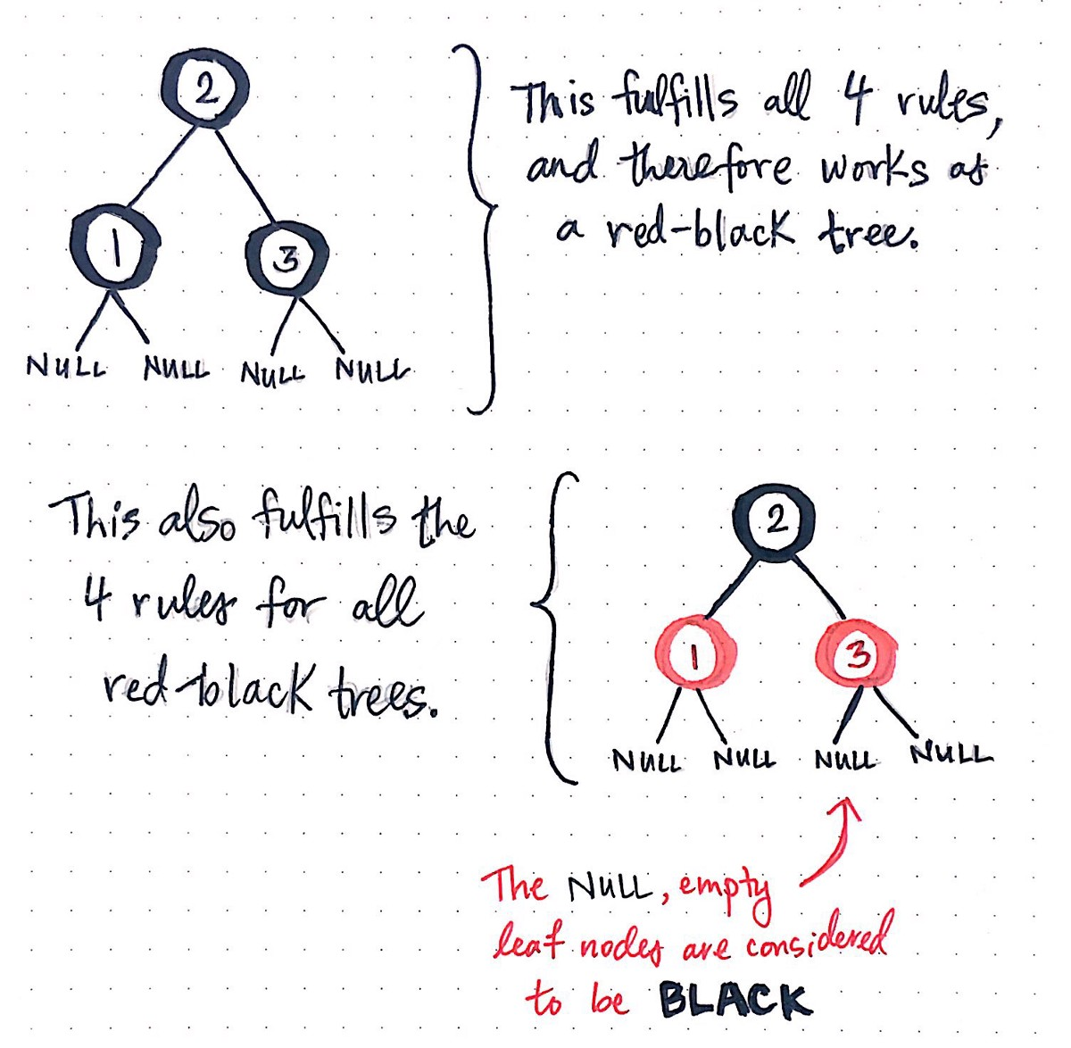
Red Black Trees- Examples
Red Black Trees(CO2)

Slide 27
Theorem
Red Black Trees(CO2)
Black Height of a Red-Black Tree :
Black height is number of black nodes on a path from a node to a leaf. Leaf nodes are also counted black nodes, According to property 4 and 5, at least half the nodes on any simple path from the root to a leaf , not including the root must be black. Therefore the black height of the root must be at least h/2.

Slide 28
Theorem
Red Black Trees(CO2)
Every Red Black Tree with n nodes has height <= 2Log₂(n+1)
This can be proved using following facts: The subtree rooted at any node x contains at least 2^{bh(x)} – 1 internal nodes.
We can prove this by induction on height of subtree rooted at x. if x is the leaf(nil[T]), so the height of x is 0, then the subtree rooted at x contains at least 2^{bh(x)} – 1 = 2⁰ – 1= 0 internal nodes .
Consider an internal node x(black height bh(x)) with two children. Each child has a black height of either bh(x) or bh(x)-1, depending on whether its colour is red or black, respectively.(since atleast so we will consider bh(x)-1 to be conservative).
Therefore each child has atleast 2^{bh(x)} – 1 internal nodes and the subtree rooted at x contains at least (2^{bh(x)-1} – 1) + (2^{bh(x)-1} – 1) +1= 2. 2^{bh(x)-1} – 1= 2^{bh(x)} – 1 internal nodes.

Slide 29
Red Black Trees(CO2)
Since bh(x)>= h/2
n>=2^{bh(x)} – 1
➔n>= 2 ^{h/2} – 1
(n+1)>= 2 ^{h/2}
log(n+1).>=h/2log2
h<=2log(n+1)

Slide 30
Operations of Red Black Tree(CO2)
Insertion
Deletion
The TREE-INSERT and TREE-DELETE operations in RBT are same as BST, which runs in time O(h) in BST, where h is height of tree.
However, the result may violate the red-black properties in RBT.
To restore these properties, we must recolor some of the nodes in the tree, and make some pointer changes.
We use rotations to change the pointer structure.

Slide 31
Rotations
Operations of Red Black Tree(CO2)
Rotations are presented by the following figures.
LEFT-ROTATION and RIGHT-ROTATION run in O(1) units of time.
Only the pointers are changed – the other fields remain the same.
x
Left-Rotate(T, x)
y
α
γ
y
Right-Rotate(T, y)
x
β
γ
α
β

Slide 32
Operations of Red Black Tree(CO2)
Left-Rotate (T, x)
y ← right[x] // Set y.
right[x] ← left[y] //Turn y’s left subtree into x’s right subtree.
if left[y] ≠ nil[T ]
then p[left[y]] ← x
p[y] ← p[x] // Link x’s parent to y.
if p[x] = nil[T ]
then root[T ] ← y
else if x = left[p[x]]
then left[p[x]] ← y
else right[p[x]] ← y
left[y] ← x // Put x on y’s left.
p[x] ← y
x
Left-Rotate(T, x)
y
α
Left-Rotate(T, x)
y
γ
x
y
Right-Rotate(T, y)
x
α
γ
α
γ
β
Right-Rotate(T, y)
x
β
y
β
γ
α
β
(Similarly we can write algorithm for right rotation by exchanging x, y and left, right in above algorithm)

Slide 33
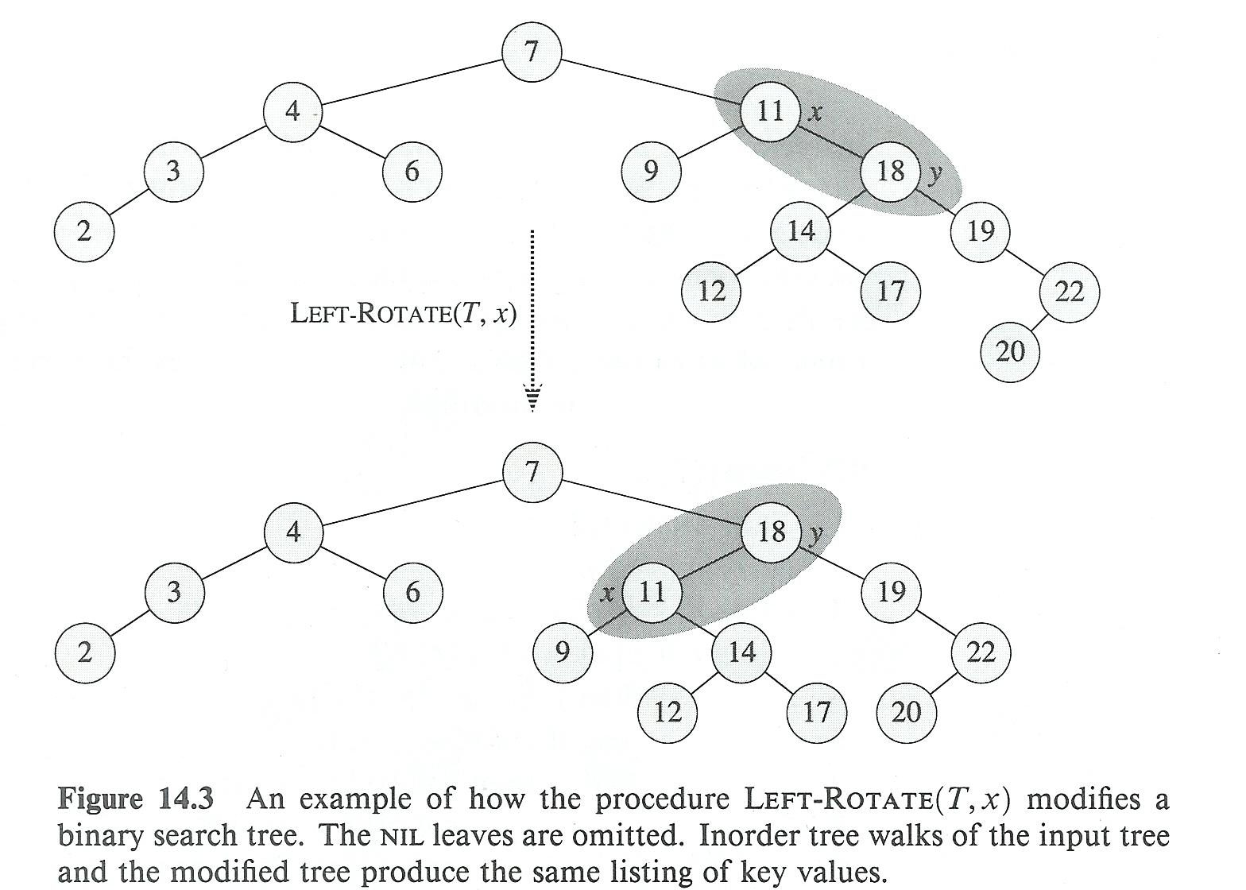
Rotations
Operations of Red Black Tree(CO2)

Slide 34
Insertion
Operations of Red Black Tree(CO2)
General description:
We begin by inserting a node z into a tree T, as if T is an ordinary BST.
We color z red.
We fix up the modified tree by re-coloring nodes and performing rotations, to guarantee that the red-black properties are preserved.
Insertion is accomplished in O( logn ) time.

Slide 35
Operations of Red Black Tree(CO2)
RB-Insert(T, z)
y ← nil[T]
x ← root[T]
while x ≠ nil[T]
do y ← x
if key[z] < key[x]
then x ← left[x]
else x ← right[x]
p[z] ← y
if y = nil[T]
then root[T] ← z
else if key[z] < key[y]
then left[y] ← z
else right[y] ← z
RB-Insert(T, z) Contd.
left[z] ← nil[T]
right[z] ← nil[T]
color[z] ← RED
RB-Insert-Fixup (T, z)
Which of the RB properties might be violated?
Fix the violations by calling RB-Insert-Fixup.

Slide 36
Insertion
Operations of Red Black Tree(CO2)
RB-Insert-Fixup (T, z)
while color[p[z]] = RED
do if p[z] = left[p[p[z]]]
then y ← right[p[p[z]]]
if color[y] = RED
then color[p[z]] ← BLACK // Case 1
color[y] ← BLACK // Case 1
color[p[p[z]]] ← RED // Case 1
z ← p[p[z]] // Case 1

Slide 37
Insertion
Operations of Red Black Tree(CO2)
RB-Insert-Fixup(T, z) (Contd.)
else if z = right[p[z]] // color[y] ≠ RED
then z ← p[z] // Case 2
LEFT-ROTATE(T, z) // Case 2
color[p[z]] ← BLACK // Case 3
color[p[p[z]]] ← RED // Case 3
RIGHT-ROTATE(T, p[p[z]]) // Case 3
else (if p[z] = right[p[p[z]]])(same as 10-14
with “right” and “left” exchanged)
color[root[T ]] ← BLACK

Slide 38
Insertion – Analysis of the code
Operations of Red Black Tree(CO2)
The only property that might be violated in line 16 of RB-INSERT is property 4: if z’s parent is red, then we have two reds in a row.
The RB-INSERT-FIXUP code pushes this violation up the tree. It is either corrected somewhere on the way up, or in the root. The other properties are maintained.
Assuming that each move up the tree takes O(1) time, the whole process ends in O(h) time, as desired.
We consider 6 cases, but 3 are symmetric copies of the other 3. It all depends on whether z’s parent p[z] is a left or a right child of z’s grandparent p[p[z]]].
*Note that there is an important assumption: the root of the tree is black!

Slide 39
Insertion – Analysis of the code
Operations of Red Black Tree(CO2)
Case 1 is distinguished from Cases 2 & 3 by the color of z’s uncle (denoted by y). If y is red then Case 1 is executed. Otherwise control passes to Cases 2 & 3.
In all cases, z’s grandfather is black (since it’s father is red).
Case 1 is shown in the following figure. [Both p[z] and y are red, and their father is black. The two sons are colored black, their father is colored red, and the possible problem is pushed up the tree].

Slide 40
Insertion Case 1 – uncle y is red
Operations of Red Black Tree(CO2)
p[p[z]]
new z
C
C
p[z]
y
A
D
A
D
α
z
δ
ε
α
δ
ε
B
B
z is a right child here.
Similar steps if z is a left child.
β
γ
γ
β
p[p[z]] (z’s grandparent) must be black, since z and p[z] are both red and there are no other violations of property 4.
Make p[z] and y black so now z and p[z] are not both red. But property 5 might now be violated.
Make p[p[z]] red to restore property 5.
The next iteration has p[p[z]] as the new z (i.e., z moves up 2 levels).

Slide 41
Insertion – Analysis of the code
Operations of Red Black Tree(CO2)
In Cases 2 & 3 the color of z’s uncle, y is black.
The two are distinguished by whether z is the right child or the left child of p[z].
Using a left rotation we can move from Case 2 to Case 3.
After that, z is the left son of p[z], both are red, and the uncle, y, is black.
Some color changes and a right rotation are necessary, but there is no need to continue the while loop, since p[z] is colored black.
The following figure sums this up.

Slide 42
Insertion Case 2 – y is black, z is a right child
Operations of Red Black Tree(CO2)
C
C
p[z]
p[z]
A
δ
D
y
B
δ
D
y
z
α
B
z
A
γ
γ
α
β
β
Left rotate around p[z], p[z] and z switch roles so now z is a left child, and both z and p[z] are red.
Takes us immediately to case 3.

Slide 43
Insertion Case 3 – y is black, z is a left child
Operations of Red Black Tree(CO2)
C
B
p[z]
B
A
C
δ
y
z
α
β
γ
δ
A
γ
α
β
Make p[z] black and p[p[z]] red.
Then right rotate on p[p[z]]. Ensures property 4 is maintained.
No longer have 2 reds in a row.
p[z] is now black so no more iterations.

Slide 44
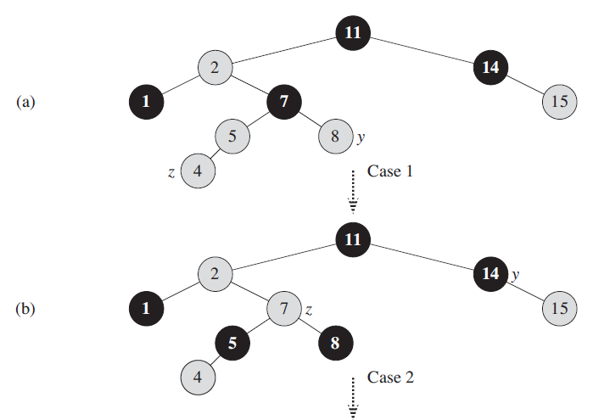
Example of Insertion in RB Tree “ inserting 4”
Operations of Red Black Tree(CO2)

Slide 45
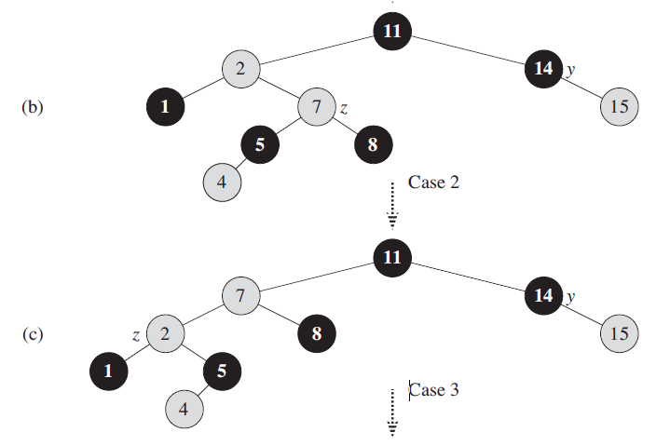
Example of Insertion in RB Tree
Operations of Red Black Tree(CO2)

Slide 46
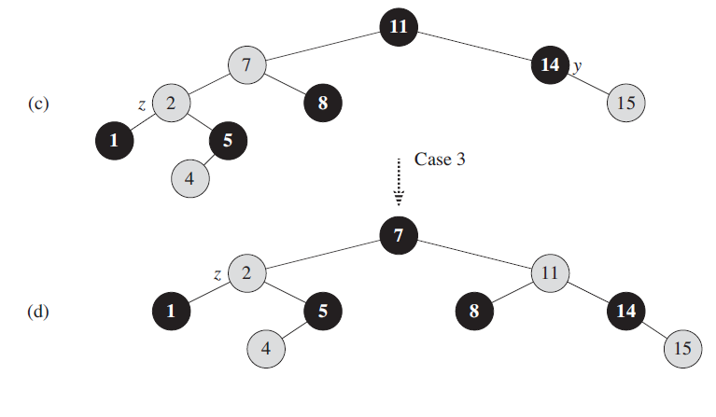
Example of Insertion in RB Tree
Operations of Red Black Tree(CO2)

Slide 47
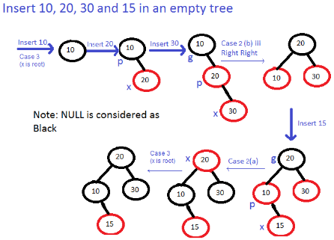
Operations of Red Black Tree(CO2)
Example-2 of Insertion in RB Tree

Slide 48
Deletion Operation in RBT
Operations of Red Black Tree(CO2)
The procedure we use is called RB-DELETE.
It deletes a node like in a “regular” binary search tree, and then calls the procedure RB-DELETE-FIXUP to fix colors and perform rotations, to restore the red-black properties.

Slide 49
Deletion
Operations of Red Black Tree(CO2)
RB-Delete(T, z)
if left[z] = nil[T] or right[z] = nil[T]
then y ← z
else y ← TREE-SUCCESSOR(z)
if left[y] = nil[T ]
then x ← left[y]
else x ← right[y]
p[x] ← p[y] // Do this, even if x is nil[T]

Slide 50
Deletion
Operations of Red Black Tree(CO2)
RB-Delete (T, z) (Contd.)
if p[y] = nil[T ]
then root[T ] ← x
else if y = left[p[y]]
then left[p[y]] ← x
else right[p[y]] ← x
if y = z
then key[z] ← key[y]
copy y’s satellite data into z
if color[y] = BLACK
then RB-Delete-Fixup(T, x)
return y
The node passed to the fixup routine is the lone child of the spliced up node, or the sentinel.

Slide 51
Operations of Red Black Tree(CO2)
RB-Delete-Fixup(T, x)
while x ≠ root[T ] and color[x] = BLACK
do if x = left[p[x]]
then w ← right[p[x]]
if color[w] = RED
then color[w] ← BLACK // Case 1
color[p[x]] ← RED // Case 1
LEFT-ROTATE(T, p[x]) // Case 1
w ← right[p[x]] // Case 1

Slide 52
Operations of Red Black Tree(CO2)
RB-Delete-Fixup(T, x) (Contd.)
/* x is still left[p[x]] */
if color[left[w]] = BLACK and color[right[w]] = BLACK
then color[w] ← RED // Case 2
x ← p[x] // Case 2
else if color[right[w]] = BLACK
then color[left[w]] ← BLACK // Case 3
color[w] ← RED // Case 3
RIGHT-ROTATE(T,w) // Case 3
w ← right[p[x]] // Case 3
color[w] ← color[p[x]] // Case 4
color[p[x]] ← BLACK // Case 4
color[right[w]] ← BLACK // Case 4
LEFT-ROTATE(T, p[x]) // Case 4
x ← root[T ] // Case 4
else (same as then clause with “right” and “left” exchanged)
color[x] ← BLACK

Slide 53
Case 1 – w is red
Operations of Red Black Tree(CO2)
p[x]
B
D
x
w
A
D
B
E
α
β
x
new w
ε
ζ
A
C
C
E
α
β
γ
δ
γ
δ
ε
ζ
w must have black children.
Make w black and p[x] red (because w is red p[x] couldn’t have been red).
Then left rotate on p[x].
New sibling of x was a child of w before rotation so it must be black.
Go immediately to case 2, 3, or 4.

Slide 54
Case 2 – w is black, both w’s children are black
Operations of Red Black Tree(CO2)
p[x]
c
new x
B
c
B
x
w
A
D
A
D
α
β
α
β
C
E
C
E
γ
δ
ε
ζ
γ
δ
ε
ζ
Take 1 black off x (⇒ singly black) and off w (⇒ red).
Move that black to p[x].
Do the next iteration with p[x] as the new x.
If entered this case from case 1, then p[x] was red so new x is red &
black and color attribute of new x is RED hence loop terminates. Then new x is made black in the last line.

Slide 55
Case 3 – w is black, w’s left child is red, w’s right child is black
Operations of Red Black Tree(CO2)
c
B
c
B
x
w
x
new w
A
D
A
C
α
β
α
β
D
C
E
γ
δ
E
γ
δ
ε
ζ
ε
ζ
Make w red and w’s left child black.
Then right rotate on w.
New sibling w of x is black with a red right child ⇒ case 4.

Slide 56
Case 4 – w is black, w’s right child is red
Operations of Red Black Tree(CO2)
c
B
D
x
w
A
D
B
E
α
β
x
ε
ζ
c’
A
C
C
E
α
β
γ
δ
γ
δ
ε
ζ
Make w be p[x]’s color (c).
Make p[x] black and w’s right child black.
Then left rotate on p[x].
Remove the extra black on x (⇒ x is now singly black) without violating any red-black properties.
Setting x to root causes the loop to terminate.

Slide 57
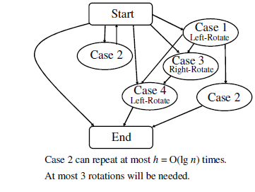
Deletion Flow Chart
Operations of Red Black Tree(CO2)

Slide 58
Points to Remember While Considering Symmetric Cases for Insertion in R-B Tree
Operations of Red Black Tree(CO2)
A- If P[z] is left child
Case1: If z’s uncle y is red.
Case2: If z’s uncle y is black and z is the right child.
Case3: If z’s uncle y is black and z is the left child.
B- If P[z] is right child
Case1: If z’s uncle y is red.
Case2: If z’s uncle y is black and z is the left child.
Case3: If z’s uncle y is black and z is the right child.
Earlier we have discussed different cases according to A(If P[z] is left child ).For B(If P[z] is right child) just exchange every left and right i.e. left rotation will become right rotation and left child will become right child and vice versa.

Slide 59
Points to Remember While Considering Symmetric Cases for Deletion in R-B Tree
Operations of Red Black Tree(CO2)
A- If x is left child
Case1: If x’s sibling w is red.
Case2: If x’s sibling w is black and both of w’s children are black.
Case3: If x’s sibling w is black , w’s left child is red and w’s right child is black.
Case 4: If x’s sibling w is black and w’s right child is red.
B- If x is right child
Case1: If x’s sibling w is red.
Case2: If x’s sibling w is black and both of w’s children are black.
Case3: If x’s sibling w is black , w’s right child is red and w’s left child is black.
Case 4: If x’s sibling w is black and w’s left child is red.
Earlier we have discussed different cases according to A(If x is left child ).
For B(If x is right child) just exchange every left and right i.e. left rotation will become right rotation and left child will become right child and vice versa.

Slide 60
BTrees(CO2)- Objective
The objective of this topic is make students understand about
B Tree
Properties
Structure
Operations

Slide 61
Prerequisite and Recap
Prerequisite
Trees
Different Operations of trees (Insertion, Deletion, updating, searching)
Binary Search Trees.
Recap
Algorithm analysis
Red Black Trees

Slide 62
B-Tree(CO2)
B-Tree is a self-balancing search tree.
In most of the other self-balancing search trees (like AVL and Red-Black Trees), it is assumed that everything is in main memory.
To understand the use of B-Trees, we must think of the huge amount of data that cannot fit in main memory.
When the number of keys is high, the data is read from disk in the form of blocks.
Disk access time is very high compared to main memory access time.
The main idea of using B-Trees is to reduce the number of disk accesses.
Most of the tree operations (search, insert, delete, max, min, ..etc ) require O(h) disk accesses where h is the height of the tree.

Slide 63
B-Tree(CO2)
Properties of B-Tree 1) All leaves are at same level. 2) A B-Tree is defined by the term minimum degree ‘t’. The value of t depends upon disk block size. 3) Every node except root must contain at least t-1 keys. Root may contain minimum 1 key. 4) All nodes (including root) may contain at most 2t – 1 keys. 5) Number of children of a node is equal to the number of keys in it plus 1. 6) All keys of a node are sorted in increasing order. The child between two keys k1 and k2 contains all keys in the range from k1 and k2. 7) B-Tree grows and shrinks from the root which is unlike Binary Search Tree. Binary Search Trees grow downward and also shrink from downward. 8) Like other balanced Binary Search Trees, time complexity to search, insert and delete is O(Logn).

Slide 64
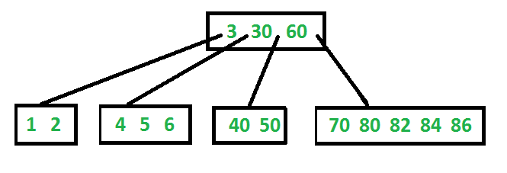
B-Tree(CO2)
Following is an example B-Tree of minimum degree 3.

Slide 65
B-Tree(CO2)
Search Operation
Search is similar to the search in Binary Search Tree.
Let the key to be searched be k.
We start from the root and recursively traverse down.
For every visited non-leaf node, if the node has the key, we simply return the node.
Otherwise, we recur down to the appropriate child (The child which is just before the first greater key) of the node.
If we reach a leaf node and don’t find k in the leaf node, we return NULL.

Slide 66
B-Tree(CO2)
Nomenclature
x = a pointer to some object
DISK-READ(x)
//operations that access and/or modify the attributes of x
DISK-WRITE(x)
// omitted if no attributes of x were changed
other operations that access but do not modify attributes of x

Slide 67
B-Tree(CO2)
B-TREE -SEARCH(x, k)
1. i = 1
2. while i <= x.n and k > x.key_{i}
3. i = i + 1
4. if i .x<= n and k == x.key_{i}
5. return (x,i)
6. elseif x.leaf
7. return NIL
8. else DISK-READ (x.c_{i})
9. return B-TREE-SEARCH(x. c_{i ,}k)

Slide 68
B-Tree(CO2)
B-TREE -SEARCH(x, k)
As in the TREE-SEARCH procedure for binary search trees, the nodes encountered during the recursion form a simple path downward from the root of the tree.
The B-TREE-SEARCH procedure therefore accesses O(h)= O(log_{t}n) disk pages, where h is the height of the B-tree and n is the number of keys in the B-tree.
Since x.n < 2t, so it takes O(t) time within each node, and the total CPU time is O(th)= O(tlog_{t} n).

Slide 69
Creation of a Node
B-Tree(CO2)
B-TREE-CREATE(T)
1. x = ALLOCATE-NODE
2. x.leaf= TRUE
3 x:n=0
4. DISK-WRITE(x)
5. T.root=x

Slide 70
B Tree Insertion
B-Tree(CO2)
B-TREE-INSERT(T, k)
1 r = T.root
2 if r.n == 2t-1
3. s = ALLOCATE-NODE()
4. T.root = s
5. s.leaf = FALSE
6. s.n = 0
7. s.c₁ ₌ r
8. B-TREE-SPLIT-CHILD(s,1)
9. B-TREE-INSERT-NONFULL(s, k)
else B-TREE-INSERT-NONFULL(r, k)
We insert a key k into a B-tree T of height h in a single pass down the tree, requiring O(h) disk accesses. The CPU time required is O(th)=O(tlog_{t}n).

Slide 71
Insertion in B-Tree(CO2)
In a B-Tree, the new element must be added only at leaf node. That means, always the new key Value is attached to leaf node only. The insertion operation is performed as follows...
Step 1: Check whether tree is Empty.
Step 2: If tree is Empty, then create a new node with new key value and insert into the tree as a root node.
Step 3: If tree is Not Empty, then find a leaf node to which the new key value cab be added using Binary Search Tree logic.
Step 4: If that leaf node has an empty position, then add the new key value to that leaf node by maintaining ascending order of key value within the node.
Step 5: If that leaf node is already full, then split that leaf node by sending middle value to its parent node. Repeat tha same until sending value is fixed into a node.
Step 6: If the splitting is occurring to the root node, then the middle value becomes new root node for the tree and the height of the tree is increased by one.

Slide 72
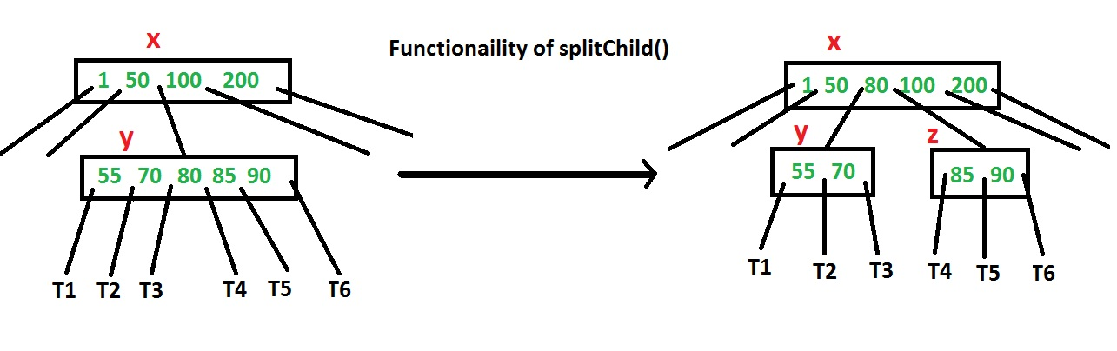
Insertion in B-Tree(CO2)

Slide 73


Insertion in B-Tree(CO2)
Example- Insert the sequence of integers 10,20,30,40,50,60,70,80,90 in an initially empty B-Tree.
Initially root is NULL. Let us first insert 10.
Let us now insert 20, 30, 40 and 50. They all will be inserted in root because the maximum number of keys a node can accommodate is 2*t – 1 which is 5.

Slide 74
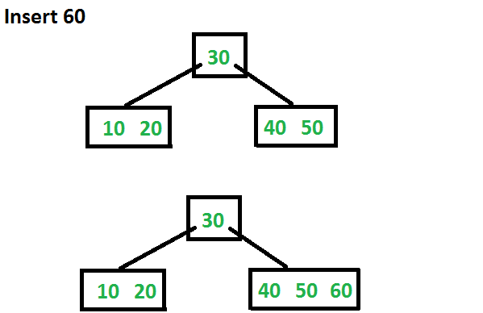
Insertion in B-Tree(CO2)
Let us now insert 60. Since root node is full, it will first split into two, then 60 will be inserted into the appropriate child.

Slide 75
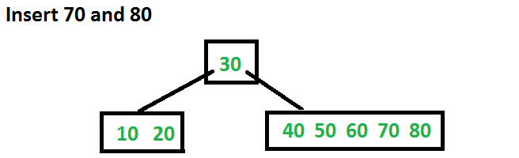
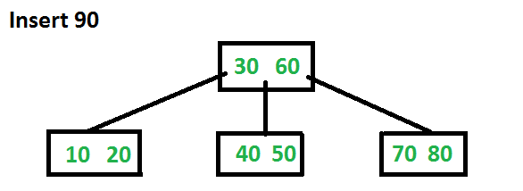
Insertion in B-Tree(CO2)
Let us now insert 70 and 80. These new keys will be inserted into the appropriate leaf without any split.
Let us now insert 90. This insertion will cause a split. The middle key will go up to the parent.

Slide 76
Deletion in BTree(CO2)
If a node doesn’t maintain the minimum key values it leads to the condition of underflow. In the condition of underflow some pointers need to be adjusted.
If it is a leaf node
Case1: After deletion the node doesn’t suffer from underflow then there is no problem.
Case2: By deleting the key the node suffer from underflow.
A: If the sibling of the node has more than one key value then BORROW from the sibling.
B: If A not possible then underflow node will be combined with its sibling together with parent which separate them-FUSION.
If it is a internal nodes
Case 3: Deletion of a key in internal nodes, find the in order successor/ predecessor and replace the desired key with in order successor / in order Predecessor and remove the key.

Slide 77
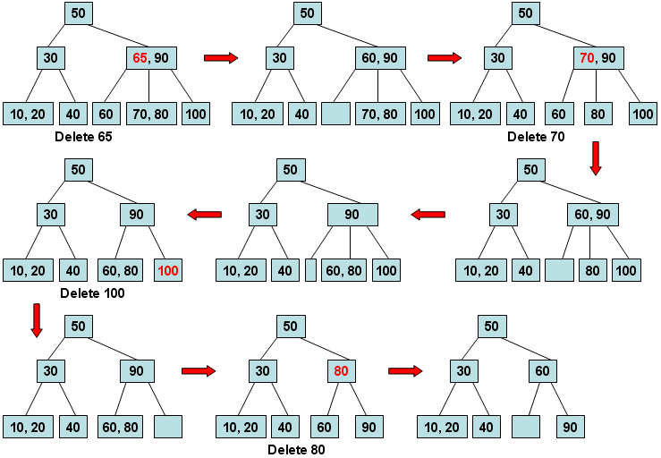
Deletion in BTree(CO2)

Slide 78
Binomial Heap(CO2)- Objective
The objective of this topic is make students understand about
Binomial Trees
Binomial Heap
Structure
Operations

Slide 79
Prerequisite and Recap
Prerequisite
Trees
Different Operations of trees (Insertion, Deletion, updating, searching)
Binary Search Trees.
Recap
Algorithm analysis
B-Tree

Slide 80
Binomial Heap (CO2)
If we don’t need the UNION operation, ordinary binary heaps, as used in heapsort work well.
Operations other than UNION run in worst-case time O(lg n) (or better) on a binary heap.
If the UNION operation must be supported, however, binary heaps perform poorly.
By concatenating the two arrays that hold the binary heaps to be merged and then running MIN-HEAPIFY , the UNION operation takes (n) time in the worst case.

Slide 81
Binomial Heap (CO2)
A Binomial Heap is a collection of Binomial Trees.
Binomial Tree: A binomial tree of order k is defined recursively: ・
Order 0: single node.
Order k: one binomial tree of order k – 1 linked to another of order k – 1.
Properties Binomial Tree - It has exactly 2^{k} nodes. - It has depth as k. - There are exactly ^{k}C_{i} nodes at depth i for i = 0, 1, . . . , k. - The root has degree k and children of root are themselves
Binomial Trees with order k-1, k-2,.. 0 from left to right.

Slide 82
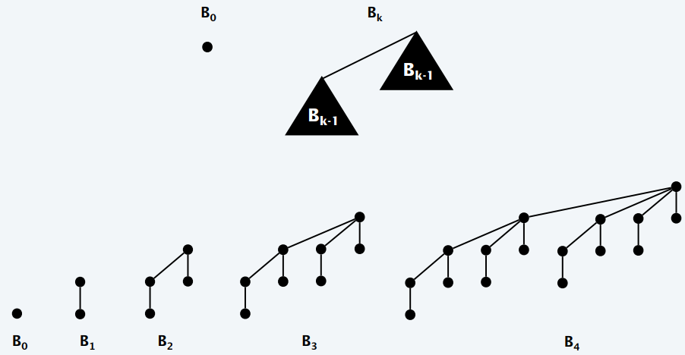
Binomial Heap (CO2)
Structure of Binomial Tree

Slide 83
Binomial Heap (CO2)
B₂
B₁
B₁
B₀
B₁
B₀
B₁
B₂
B₃
B₃
B₂
B₀
B₁
B₄

Slide 84
Binomial Heap (CO2)
A BINOMIAL HEAP H is a set of BINOMIAL TREES that satisfies the
following “Binomial Heap Properties”
Each binomial tree in H is HEAP-ORDERED
the key of a node is ≥ the key of the parent
Root of each binomial tree in H contains the smallest key in that tree.
2. There is at most one binomial tree in H whose root has a degree
k n-node binomial heap H consists of at most lgn+ 1 binomial
trees.

Slide 85
Binomial Heap(CO2)
Fields of a node(x) in Binomial heaps
node x contains following fields
-p[x] :point to its parent,
-child[x] : point to its leftmost child
-sibling[x] :point to the sibling of x immediately to its right
degree[x]: which is the number of children of x.
Key[x]: key value of x

Slide 86
Representation of Binomial Heap(CO2)
HEAD [H]
10
10
ROOT LIST (LINKED LIST)
10
10
10
10
parent
key
10
10
10
10
10
degree
10
10
10
10
10
child
10
sibling
10
10
10
10
10
10
10
10

Slide 87
Operations on Binomial Heap(CO2)
CREATING A NEW BINOMIAL HEAP
MAKE-BINOMIAL-HEAP ( )
allocate H
head [ H ] ← NIL
return H
end
RUNNING-TIME= Θ(1)

Slide 88
Operations on Binomial Heap(CO2)
BINOMIAL-HEAP-MINIMUM (H)
x ← Head [H]
min ← key [x]
x ← sibling [x]
while x ≠ NIL do
if key [x] < min then
min ← key [x]
y ← x
endif
x ← sibling [x]
endwhile
return y
end

Slide 89
Operations on Binomial Heap(CO2)
BINOMIAL-HEAP-MINIMUM (H)
Since binomial heap is HEAP-ORDERED
The minimum key must reside in a ROOT NODE
Above procedure checks all roots
NUMBER OF ROOTS ≤ lgn + 1
RUNNING TIME = O (lgn)

Slide 90
Uniting Two Binomial Heaps
Operations on Binomial Heap(CO2)
BINOMIAL-HEAP-UNION
Procedure repeatedly link binomial trees whose roots have the
same degree
BINOMIAL-LINK
Procedure links the B_{k-1} tree rooted at node y to the B_{k-1} tree rooted at node z it makes z the parent of y
i.e. Node z becomes the root of a B_{k} tree

Slide 91
Uniting Two Binomial Heaps
Operations on Binomial Heap(CO2)
BINOMIAL-LINK (y,z)
p [y] ← z
sibling [y] ← child [z]
child [z] ← y
degree [z] ←degree [z] + 1
end

Slide 92
Operations on Binomial Heap(CO2)
Uniting Two Binomial Heaps
NIL
_{z}
₊₁
child[z]
p[y]
NIL
sibling [y]

Slide 93
Uniting Two Binomial Heaps
Operations on Binomial Heap(CO2)
We maintain 3 pointers into the root list
x = points to the root currently being examined
prev-x = points to the root PRECEDING x on the root list sibling
[prev-x] = x
next-x = points to the root FOLLOWING x on the root list sibling
[x] = next-x

Slide 94
Uniting Two Binomial Heaps
Operations on Binomial Heap(CO2)
Initially, there are at most two roots of the same degree
Binomial-heap-merge guarantees that if two roots in h have the same degree they are adjacent in the root list
During the execution of union, there may be three roots of the same degree appearing on the root list at some time

Slide 95
Union Operation on Binomial Heap(CO2)
CASE 1: Occurs when degree [x] ≠ degree [next-x]
prev-x x next-x sibling { next-x}
a
b
c
d
B_{k} B_{l}
l >k
prev-x x next-x
a
b
c
d
B_{k} B_{l}

Slide 96
Union Operation on Binomial Heap(CO2)
CASE 2: Occurs when x is the first of 3 roots of equal degree
degree [x] = degree [next-x] = degree [sibling[next-x]]
prev-x x next-x sibling [next-x]
a
b
c
d
B_{K} B_{K} B_{K}
prev-x x next-x
a
b
c
d
B_{K} B_{K} B_{K}
Notes:
⇓

Slide 97
Union Operation on Binomial Heap(CO2)
CASE 3 & 4: Occur when x is the first of 2 roots of equal degree
degree [x] = degree [next-x] ≠ degree [sibling [next-x]]
Occur on the next iteration after any case
Always occur immediately following CASE 2
Two cases are distinguished by whether x or next-x has the smaller key
The root with the smaller key becomes the root of the linked tree

Slide 98
Union Operation on Binomial Heap(CO2)
CASE 3 & 4 CONTINUED
prev-x x next-x sibling [next-x]
a
b
c
d
B_{k} B_{k} B_{l} l > k
prev-x x next-x
CASE 3
a
b
d
key [b] ≤ key [c]
c
prev-x x next-x
CASE 4
a
c
d
b
key [c] ≤ key [b]

Slide 99
Union Operation on Binomial Heap(CO2)
The running time of binomial-heap-union operation is O (lgn)
Let H₁ & H₂ contain n₁ & n₂ nodes respectively where n= n₁+n₂
Then, H₁ contains at most lgn₁ +1 roots
H₂ contains at most lgn₂ +1 roots
So H contains at most
lgn₁ + lgn₂ +2 ≤ 2 lgn +2= O (lgn) roots
immediately after BINOMIAL-HEAP-MERGE
Therefore, BINOMIAL-HEAP-MERGE runs in O(lgn) time and
BINOMIAL-HEAP-UNION runs in O (lgn) time

Slide 100
Union Operation on Binomial Heap(CO2)
BINOMIAL-HEAP-MERGE PROCEDURE
Merges the root lists of H₁ & H₂ into a single linked-list
- Sorted by degree into monotonically increasing order

Slide 101
Union Operation on Binomial Heap(CO2)
BINOMIAL-HEAP-UNION (H₁,H₂)
H ← MAKE-BINOMIAL-HEAP ( )
head [ H ] ← BINOMIAL-HEAP-MERGE (H₁,H₂)
free the objects H₁ & H₂ but not the lists they point to
prev-x ← NIL
x ← HEAD [H]
next-x ← sibling [x]
while next-x ≠ NIL do
if ( degree [x] ≠ degree [next-x] OR
(sibling [next-x] ≠ NIL and degree[sibling [next-x]] = degree [x]) then
prev-x ← x CASE 1 and 2
x ← next-x CASE 1 and 2
elseif key [x] ≤ key [next-x] then
sibling [x] ← sibling [next -x] CASE 3

Slide 102
Binomial-Heap-Union Procedure (Cont.)
Union Operation on Binomial Heap(CO2)
BINOMIAL- LINK (next-x, x) CASE 3
else
if prev-x = NIL then
head [H] ← next-x CASE 4
else CASE 4
sibling [prev-x] ← next-x CASE 4
endif
BINOMIAL-LINK(x, next-x) CASE 4
x ← next-x CASE 4
endif
next-x ← sibling [x]
endwhile
return H
end

Slide 103
Insert Operation on Binomial Heap(CO2)
BINOMIAL-HEAP-INSERT (H,x)
H' ← MAKE-BINOMIAL-HEAP (H, x)
P [x] ← NIL
child [x] ← NIL
sibling [x] ← NIL
degree [x] ← O
head [H’] ← x
H ← BINOMIAL-HEAP-UNION (H, H’)
end
RUNNING-TIME= O(lg n)

Slide 104
Minimum key from Binomial Heap(CO2)
BINOMIAL-HEAP-EXTRACT-MIN (H)
(1) find the root x with the minimum key in the
root list of H and remove x from the root list of H
(2) H’ ← MAKE-BINOMIAL-HEAP ( )
(3) reverse the order of the linked list of x’ children
and set head [H’] ← head of the resulting list
(4) H ← BINOMIAL-HEAP-UNION (H, H’)
return x
end
Analysis
Unite binomial heaps H= {B₀ ,B₁,B₄} and H’ = {B₀ ,B₁,B₂}
Running time if H has n nodes each of lines 1-4 takes O(lgn) time

Slide 105
Extracting the Node with the Minimum Key
Minimum key from Binomial Heap(CO2)
x
head [H]
B₀
B₁
B₄
B₁
B₀
B₂

Slide 106
Extracting the Node with the Minimum Key
Minimum key from Binomial Heap(CO2)
x
head [H]
B₀
B₁
B₄
B₂
B₁
B₀
head [H’]

Slide 107
Decrease key from Binomial Heap(CO2)
BINOMIAL-HEAP-DECREASE-KEY (H, x, k)
key [x] ← k
y ← x
z ← p[y]
while z ≠ NIL and key [y] < key [z] do
exchange key [y] ← key [z]
exchange satellite fields of y and z
y ← z
z ← p [y]
endwhile
End
Analysis
Similar to DECREASE-KEY in BINARY HEAP
BUBBLE-UP the key in the binomial tree it resides in.
RUNNING TIME: O(lgn)

Slide 108
Deleting key from Binomial Heap(CO2)
BINOMIAL- HEAP- DELETE (H,x)
y ← x
z ← p [y]
while z ≠ NIL do
key [y] ← key [z]
satellite field of y ← satellite field of z
y ← z ; z ← p [y]
endwhile
H’← MAKE-BINOMIAL-HEAP
remove root z from the root list of H reverse the order of the linked list of z’s children and set head [H’] ← head of the resulting list
H ← BINOMIAL-HEAP-UNION (H, H’)
H’ ← MAKE-BINOMIAL-HEAP
remove root z from the root list of H reverse the order of the linked list of z’s children set head [H’] ← head of the resulting list
H ← BINOMIAL-HEAP-UNION (H, H’)
end
RUNNING-TIME= O(lg n)

Slide 109
Deleting key from Binomial Heap(CO2)
Basic idea.
Similar to binomial heaps, but less rigid structure.
Binomial heap: eagerly consolidate trees after each insert.
Fibonacci heap: lazily defer consolidation until next delete-min.

Slide 110
Fibonacci Heap(CO2)- Objective
The objective of this topic is make students understand about
Fibonacci Heap
Structure
Operations

Slide 111
Prerequisite and Recap
Prerequisite
Trees
Different Operations of trees (Insertion, Deletion, updating, searching)
Recap
Binomial Heaps

Slide 112
Fibonacci Heap(CO2)
It is a collection of trees with min-heap or max-heap property.
Root list has the root of all trees. Min[h] pointer point to the min. key node in root list.
All the nodes in the heap are connected by doubly circular link list.

Slide 113
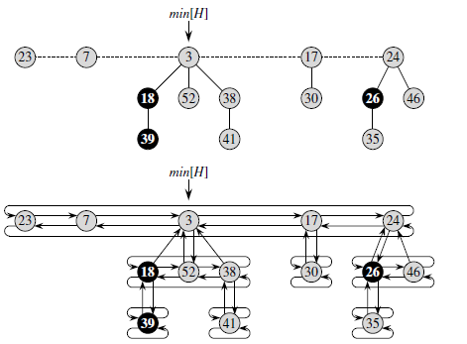
Fibonacci Heap(CO2)

Slide 114
INSERTION
Fibonacci Heap(CO2)
FIB-HEAP-INSERT(H, x)
1. degree[x] =0
2. p[x] =NIL
3. child[x] =NIL
4 .left[x]=x
5. right[x]=x
6. mark[x]=FALSE
7. concatenate the root list containing x with root list H
8 .if min[H] = NIL or key[x] < key[min[H]]
9. then min[H] =x
10. n[H] =n[H] + 1

Slide 115
Analysis of Insertion Algorithm
Fibonacci Heap(CO2)
lines 1-6 initialize the structural fields of node x, making it its own circular, doubly linked list ,
line 7 adds x to the root list of H in O(1) actual time. Thus, node x becomes a single-node heap-ordered tree, and thus an unordered binomial tree, in the Fibonacci heap. It has no children and is unmarked.
Lines 8-9 then update the pointer to the minimum node of Fibonacci heap H if necessary.
Finally, line 10 increments n[H] to reflect the addition of the new node.
Unlike the BINOMIAL-HEAP-INSERT procedure, FIB-HEAP-INSERT makes no attempt to consolidate the trees within the Fibonacci heap. If k consecutive FIB-HEAP-INSERT operations occur, then k single-node trees are added to the root list.

Slide 116
Union of Fibonacci Heaps(CO2)
Procedure unites Fibonacci heaps H₁ and H₂, destroying H₁ and H₂ in the process.
FIB-HEAP-UNION(H_{1,}H₂)
H =MAKE-FIB-HEAP()
min[H] =min[H₁]
concatenate the root list of H₂ with the root list of H
if (min[H₁] = NIL) or (min[H₂] ≠ NIL and min[H₂] < min[H₁])
then min[H]=min[H₂]
n[H] =n[H₁] + n[H₂]
free the objects H₁ and H₂
return H

Slide 117
Union of Fibonacci Heaps(CO2)
Lines 1-3 concatenate the root lists of H₁ and H₂ into a new root list H.
Lines 2, 4, and 5 set the minimum node of H, and line 6 sets n[H] to the total number of nodes.
The Fibonacci heap objects H₁ and H₂ are freed in line 7, and line 8 returns the resulting Fibonacci heap H.
As in the FIB-HEAP-INSERT procedure, no consolidation of trees occurs.

Slide 118
Fibonacci Heaps(CO2)
Linking operation. Make larger root be a child of smaller root.
larger root
smaller root
still heap-ordered
15
3
3
56
24
18
52
41
15
18
52
41
77
39
44
56
24
39
44
tree T₁
tree T₂
77
tree T'

Slide 119
Fibonacci Heaps(CO2)
Deleting minimum key
Delete min; meld its children into root list; update min.
Consolidate trees so that no two roots have same rank.
min
7
24
23
17
3
30
26
46
18
52
41
35
39
44

Slide 120
Fibonacci Heaps(CO2)
Delete min; meld its children into root list; update min.
min
7
24
23
17
18
52
41
30
26
46
39
44
35

Slide 121
Delete Min
Fibonacci Heaps(CO2)
Consolidate trees so that no two roots have same rank.
min
current
7
24
23
17
18
52
41
30
26
46
39
44
35

Slide 122
Fibonacci Heaps(CO2)
Comparing the Ranks
rank
0
1
2
3
min
current
7
24
23
17
18
52
41
30
26
46
39
44
35

Slide 123
Fibonacci Heaps(CO2)
Comparing the Ranks
rank
0
1
2
3
min
current
7
24
23
17
18
52
41
30
26
46
39
44
35

Slide 124
Fibonacci Heaps(CO2)
Delete min.
Delete min; meld its children into root list; update min.
Consolidate trees so that no two roots have same rank.
rank
0
1
2
3
min
7
24
23
17
18
52
41
30
26
46
current
39
44
35

Slide 125
Fibonacci Heaps(CO2)
Delete min.
Delete min; meld its children into root list; update min.
Consolidate trees so that no two roots have same rank.
rank
0
1
2
3
link 23 into 17
min
7
24
23
17
18
52
41
30
26
46
current
39
44
35

Slide 126
Fibonacci Heaps(CO2)
Delete min.
Delete min; meld its children into root list; update min.
Consolidate trees so that no two roots have same rank.
rank
0
1
2
3
link 17 into 7
min
7
24
17
18
52
41
30
26
46
current
23
39
44
35

Slide 127
Fibonacci Heaps(CO2)
Delete min.
Delete min; meld its children into root list; update min.
Consolidate trees so that no two roots have same rank.
rank
0
1
2
3
link 24 into 7
current
min
24
7
18
52
41
26
46
17
30
39
44
35
23

Slide 128
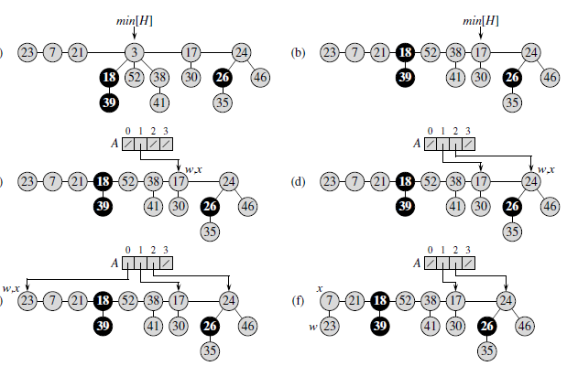
Fibonacci Heap- Example

Slide 129
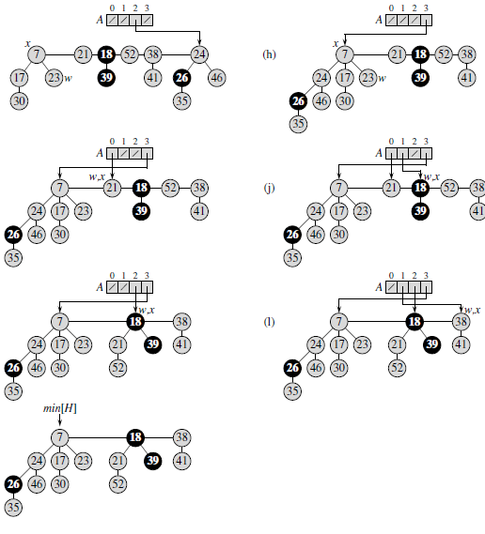
Fibonacci Heap- Example

Slide 130
Tries(CO2)- Objective
The objective of this topic is make students understand about
Tries
Structure
Operations

Slide 131
Prerequisite and Recap
Prerequisite
Trees
Different Operations of trees (Insertion, Deletion, updating, searching)
Recap
Fibonacci Heap

Slide 132
Tries(CO2)
Trie is an efficient information reTrieval data structure.
Using Trie, search complexities can be brought to optimal limit (key length).
If we store keys in binary search tree, a well balanced BST will need time proportional to M * log N, where M is maximum string length and N is number of keys in tree.
Using Trie, we can search the key in O(M) time.
Every node of Trie consists of multiple branches.
Each branch represents a possible character of keys.
We need to mark the last node of every key as end of word node.
A Trie node field isEndOfWord is used to distinguish the node as end of word node.

Slide 133
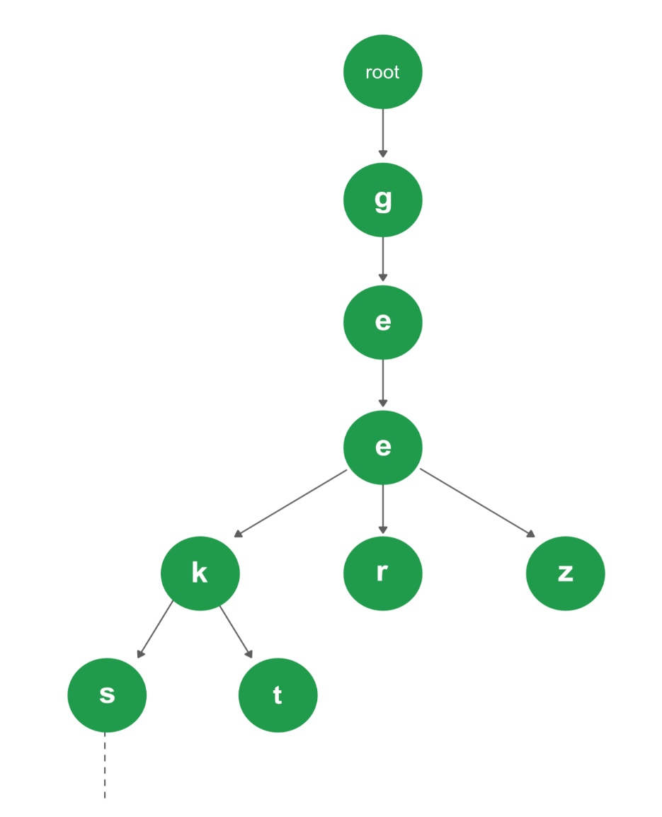
Tries(CO2)
A simple structure to represent nodes of the English alphabet can be as following,

Slide 134
Skip List(CO2)- Objective
The objective of this topic is make students understand about
Skip List
Structure
Operations

Slide 135
Prerequisite and Recap
Prerequisite
Trees
Different Operations of trees (Insertion, Deletion, updating, searching)
Recap
Tries

Slide 136
Skip List(CO2)
Skip lists are a linked list like structure which allows for fast search.
It consists of a base list holding the elements, together with a tower of lists maintaining a linked hierarchy of subsequences, each skipping over fewer elements.
We create multiple layers so that we can skip some nodes.
The upper layer works as an “express lane” which connects only main outer stations, and the lower layer works as a “normal lane” which connects every station.

Slide 137
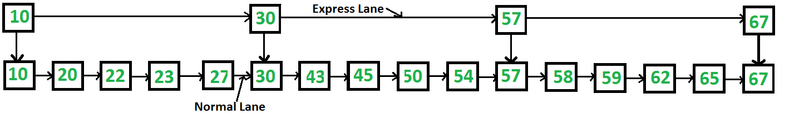
Skip List(CO2)
See the following example list with 16 nodes and two layers.. Suppose we want to search for 50, we start from first node of “express lane” and keep moving on “express lane” till we find a node whose next is greater than 50. Once we find such a node (30 is the node in following example) on “express lane”, we move to “normal lane” using pointer from this node, and linearly search for 50 on “normal lane”. In following example, we start from 30 on “normal lane” and with linear search, we find 50.

Slide 138
Faculty Video Links, Youtube & NPTEL Video Links and Online Courses Details
Self Made Video Link:
https://www.youtube.com/watch?v=CuNHn-1ipbY
Youtube/other Video Links
https://encrypted-vtbn2.gstatic.com/video?q=tbn:ANd9GcQE-7aKy6n8mzlWvUrja3-jij9Z7xJLNvazDhF1--P0D1gBLkPj
https://www.youtube.com/watch?v=3RQtq7PDHog
https://www.youtube.com/watch?v=qA02XWRTBdw
https://www.youtube.com/watch?v=w5cvkTXY0vQ
https://www.youtube.com/watch?v=7dAdqJH1WDg
https://www.youtube.com/watch?v=2WNQSgoQx-M
https://www.youtube.com/watch?v=iIiGWLP3qYE
https://www.youtube.com/watch?v=GUML34YFCZs

Slide 139
Daily Quiz
Q1. What are the differences between AVL and RB Tree.
Q2. Discuss the rotation operation of RB Tree.
Q3. what is the complexity of insertion Operation in RBT.
Q4. Discuss all the field of a node of binomial tree.
Q5. How to find the degree of a binomial tree.
Q6. How is Fibonacci heap different from Binomial heap.
Q7. What are the two steps for deleting minimum from the fibonacci heap?
Q8. What are Tries.
Q9. What is the role of skip list in real world problems.
Q10. How to perform linking operation in Fibonacci Heap.

Slide 140
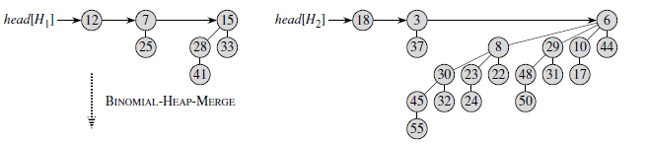
Weekly Assignment
Q1. Insert the the following nodes in RBT
<10,30,20,50,40,90,80,15,60> [CO2]
Q2. Delete the following node from RBT of Q1 in given order 20, 10, 30, 15. [CO2]
Q3. Perform the union operation on following binomial heap [CO2]

Slide 141
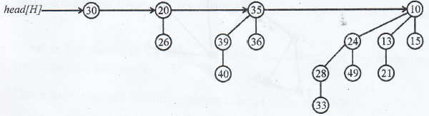
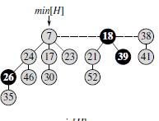
Weekly Assignment
Q4. Write a procedure which extract the minimum key node from
binomial heap. [CO2]
Q5. Write the algorithm for deleting an element from a binomial-heap.
Show the binomial-heap that results when the element 21 is
removed from H given below [CO2]
.
Q6. Decrease of a node as the following
key a) key 52 decrease by 10.
b) Key 24 decrease by 5.
[CO2]

Slide 142
MCQ s
1. What is the special property of red-black trees and what
root should always be? a) a color which is either red or black and root should
always be black color only b) height of the tree c) pointer to next node d) a color which is either green or black
2. What are the operations that could be performed in O(logn) time complexity by red-black tree? a) insertion, deletion, finding predecessor, successor b) only insertion c) only finding predecessor, successor d) for sorting

Slide 143
MCQ s
3. Which of the following is an application of Red-black trees and why? a) used to store strings efficiently b) used to store integers efficiently c) can be used in process schedulers, maps, sets d) for efficient sorting
4. Why Red-black trees are preferred over hash tables though hash
tables have constant time complexity? a) no they are not preferred b) because of resizing issues of hash table and better ordering in
redblack trees c) because they can be implemented using trees d) because they are balanced

Slide 144
MCQ s
5. How can you save memory when storing color information in Red-Black tree? a) using least significant bit of one of the pointers in the node for
color information b) using another array with colors of each node c) storing color information in the node structure d) using negative and positive numbering
6. When to choose Red-Black tree, AVL tree and B-trees? a) many inserts, many searches and when managing more items
respectively b) many searches, when managing more items respectively and
many inserts respectively c) sorting, sorting and retrieval respectively d) retrieval, sorting and retrieval respectively

Slide 145
MCQ s
7. The main distinguishable characterstic of a binomial heap from a
binary heap is that a) it allows union operations very efficiently b) it does not allow union operations that could easily be
implemented in binary heap c) the heap structure is not similar to complete binary tree d) the location of child node is not fixed i.e child nodes could be at
level (h-2) or (h-3), where h is height of heap and h>4
8.The number of trees in a binomial heap with n nodes is a) logn b) n c) nlogn d) n/2

Slide 146
MCQ s
9. What is order of resultant heap after merging two tree of order k? a) 2*k b) k+1 c) k*k d) k+logk
10. Time taken in decreasing the node value in a binomial heap is a) O(n) b) O(1) c) O(logn) d) O(nlogn)
This Objective of this unit is to make the students aware about
Advanced data structures
Red Black Tree
B Trees
Fibonacci Heap
Binomial Heap
Tries
Skip list.

Slide 147
Glossary Question
Q.1_______operations could be performed in O(logn) time complexity by red-black tree? a. insertion, deletion, finding predecessor, successor b. only insertion c. only finding predecessor, successor d. for sorting
Q.2 When inserting into a red-black tree, _________condition might happen?
a. double-red
b. double-black
c. triple-red
d. triple-black
Q.3 When deleting a node from a red-black tree, _____ condition might happen?
a. double-black
b. double-red
c. triple-red
d. triple-black

Slide 148
Glossary Question
Q.4The number of trees in a binomial heap with n nodes is______. a) logn b) n c) nlogn d) n/2
Q.5 Time taken in decreasing the node value in a binomial heap is______. a) O(n) b) O(1) c) O(logn) d) O(nlogn)
Q.6 Given a heap of n nodes.The maximum number of tree for building the heap is______. a) n b) n-1 c) n/2 d) logn

Slide 149
Glossary Question
Q.7 ________ function having same complexity for a fibonacci heap. a) Insertion, Union b) Insertion, Deletion c) extract_min, insertion d) Union, delete
Q.8 In red-black trees root should always be_______. a) black color only b) Red color only c) either Red or Black d) a color which is either green or black
Q.9 _________are the operations that could be performed in O(logn) time complexity by red-black tree? a) insertion, deletion, finding predecessor, successor b) only insertion c) only finding predecessor, successor d) for sorting

Slide 150
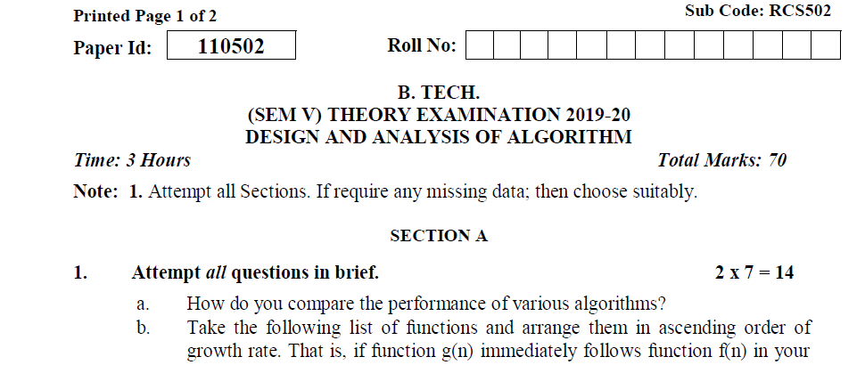
Old Question Papers(2019-2020)

Slide 151
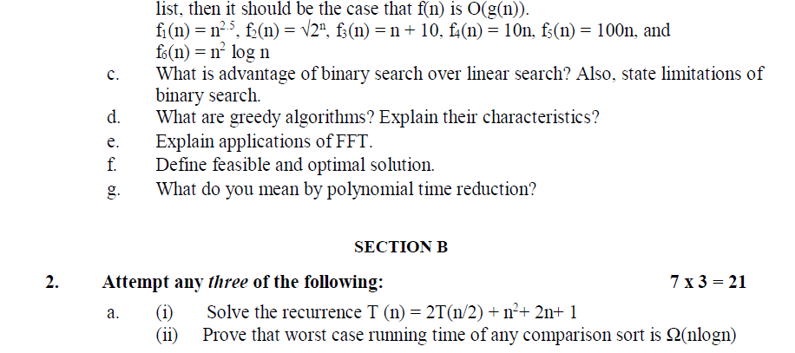
Old Question Papers(2019-2020)

Slide 152
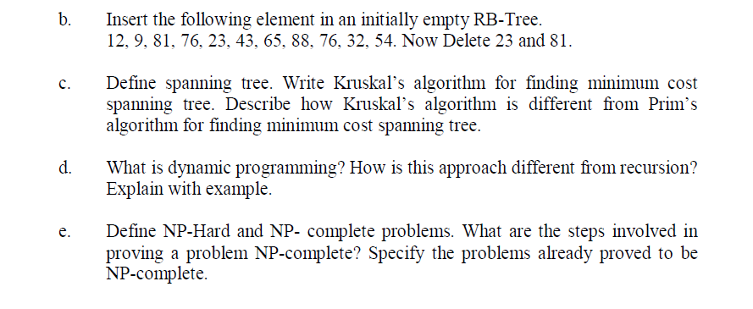
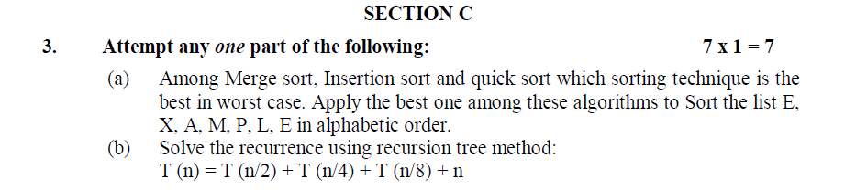
Old Question Papers(2019-2020)

Slide 153
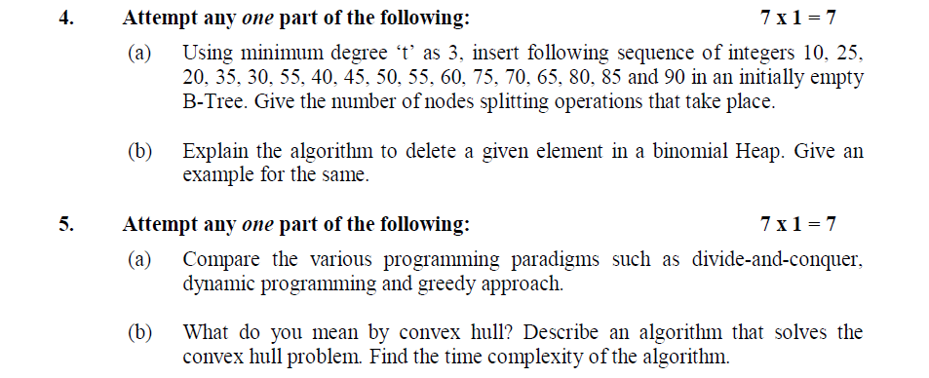
Old Question Papers(2019-2020)

Slide 154
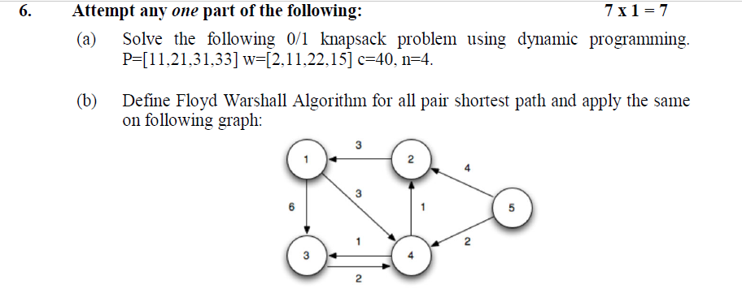
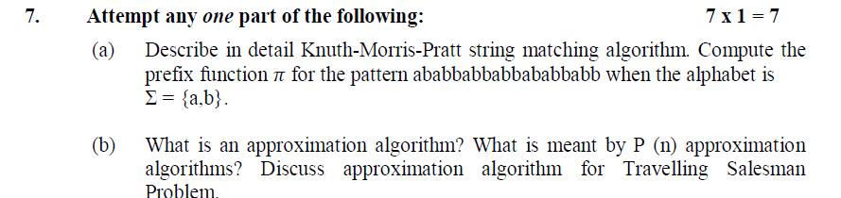
Old Question Papers(2019-2020)

Slide 155
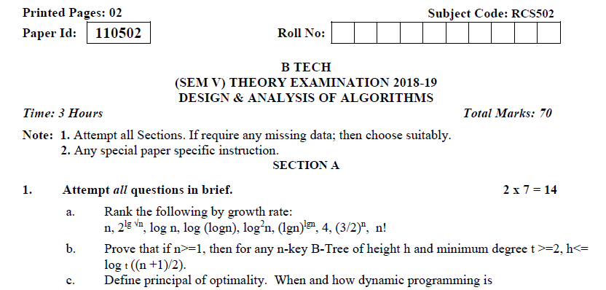
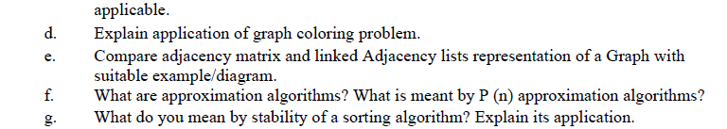
Old Question Papers(2018-2019)

Slide 156
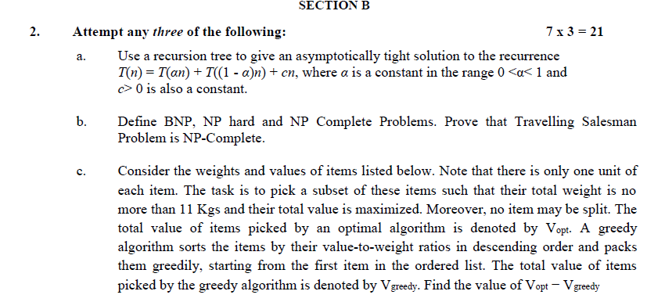
Old Question Papers(2018-2019)

Slide 157
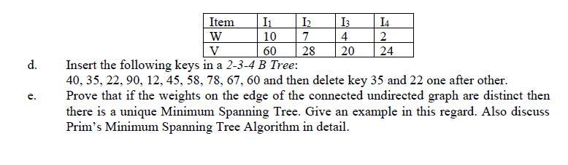
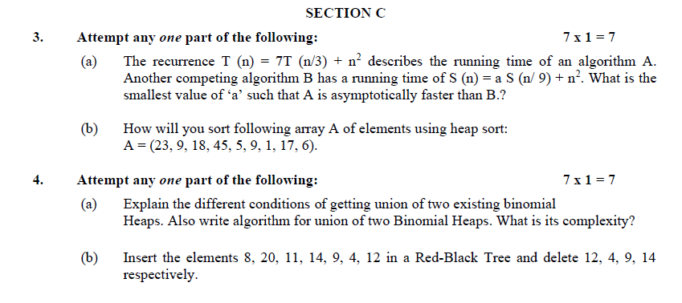
Old Question Papers(2018-2019)

Slide 158
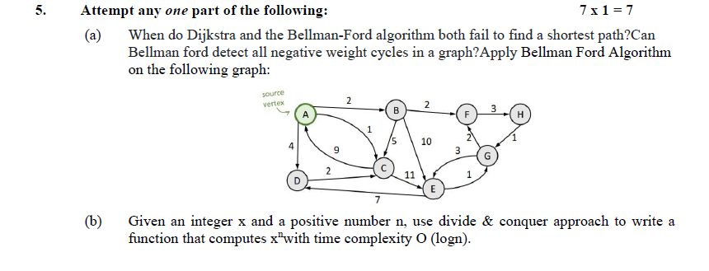
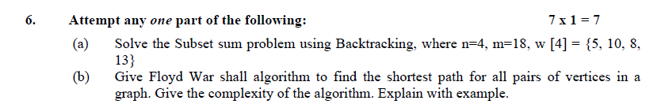
Old Question Papers(2018-2019)

Slide 159
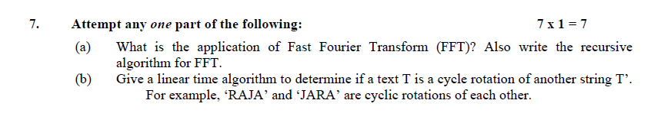
Old Question Papers(2018-2019)

Slide 160
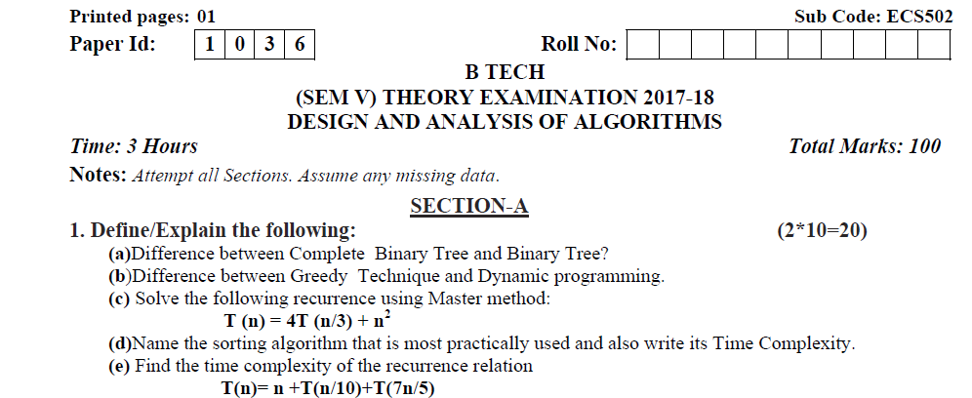
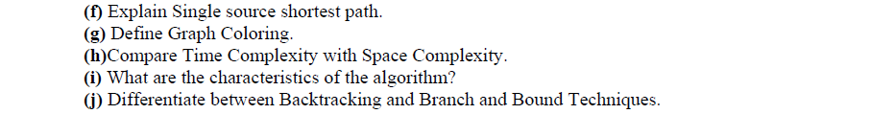
Old Question Papers(2017-2018)

Slide 161
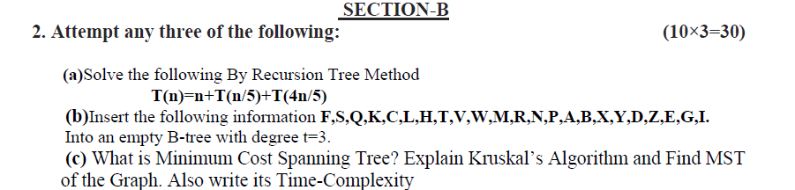
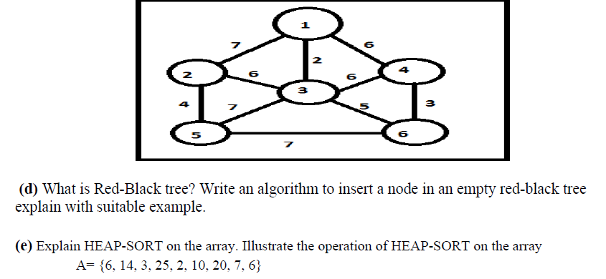
Old Question Papers(2017-2018)

Slide 162
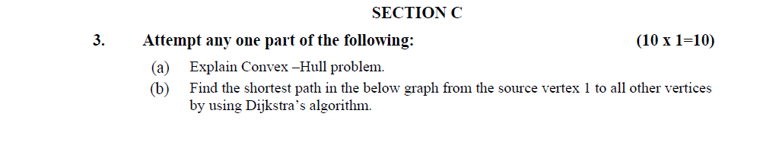
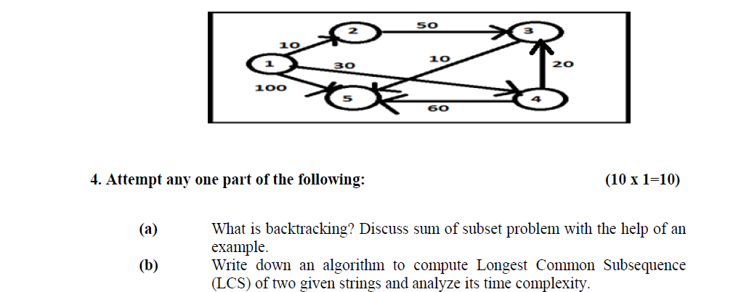
Old Question Papers(2017-2018)

Slide 163
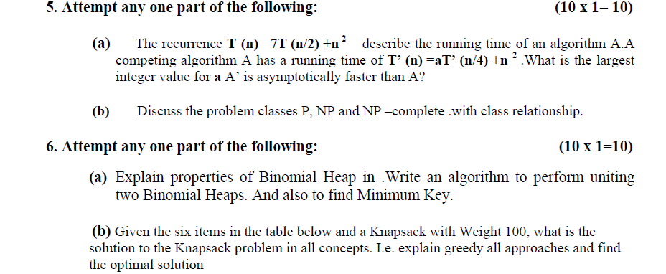
Old Question Papers(2017-2018)

Slide 164
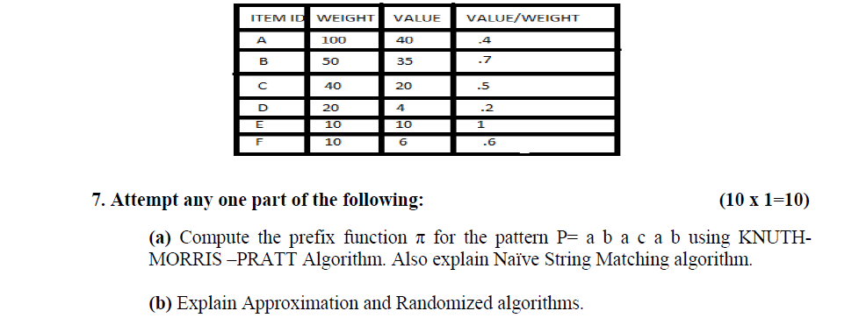
Old Question Papers(2017-2018)

Slide 165
Expected Questions for University Exam
Q1. Explain insertion in Red Black 'free. Show steps for inserting 1,2,3, 4,5, 6 ,7 ,8 & 9 into empty RB tree. [CO2]
Q2. What are the advantages of Red Black Tree over Binary Search Tree? Write algorithms to insert a key in a red black tree. Insert the following sequence of information in an empty red black tree 1, 2, 3, 4, 5, 5. [CO2]
Q3. Calculate the complexity of procedure that decrease a key in fib. Heap. [CO2]
Q4. Write the algorithm for extract an min, key node fib.heap. [CO2]
Q5. write the algorithm to decrease a key value of a node in fib. Heap. [CO2]
Q6. Write the procedure which extract min. key node from fib. Heap. [CO2]

Slide 166
Recap of Unit
This purpose of this unit is to make the students aware about the advanced data structures like Red Black Tree, B Trees, Fibonacci Heap, Binomial Heap, Tries and Skip list. It gives the insights of different Operations like union , deletion and decreasing key values.

Slide 167
References
Thomas H. Coreman, Charles E. Leiserson and Ronald L. Rivest, “Introduction to
Algorithms”, Printice Hall of India.
E. Horowitz & S Sahni, "Fundamentals of Computer Algorithms",
Aho, Hopcraft, Ullman, “The Design and Analysis of Computer Algorithms” Pearson Education, 2008.
LEE “Design & Analysis of Algorithms(POD)”, McGraw Hill
Richard E.Neopolitan ‘Foundations of Algorithms” Jones & Bartlett Learning.
Gilles Brassard and Paul Bratley, Algorithmics: Theory and Practice, Prentice Hall, 1995.

Slide 168
Unit 2
Thank You

